Slide 1


Subject:- Universal Human Value
Presented to:-
Dr.Kanika
Presented By:-
Rishab Negi CSE-B/07817702722
Ishaan Jain CSE-B/06117702722
Tarun Pandore CSE-B/07017702722
Punnay Kumar CSE-B/01117707223

Slide 2
Understanding Human Conduct
Exploring the interplay of influences on behavior and holistic solutions.

Slide 3
Introduction
This presentation explores the factors shaping human behavior, highlighting psychological, cultural, and ethical influences. It also examines holistic approaches to conflict resolution, personal development, and sustainable living for a balanced and fulfilling life.
Human behavior is shaped by internal thoughts, emotions, upbringing, and external influences like environment and culture.
Ethical decision-making helps in fostering trust, mutual respect, and fairness, ensuring harmony in personal and professional relationships.
A holistic approach to life balances mental well-being, ethical values, and sustainable living for long-term happiness.

Slide 4

01
Behavior Influences

Slide 5
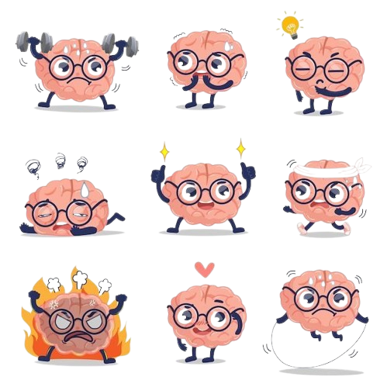
Psychological factors
Psychology plays a major role in shaping human behavior. Emotional intelligence, mental well-being, and thought processes directly influence how individuals react to different situations. Understanding psychology helps in self-improvement, developing better relationships, and making more informed life choices.
Emotions guide reactions, influencing decision-making and relationships by shaping interactions with family, friends, and colleagues.
Cognitive processes affect perceptions, shaping how individuals interpret and respond to various life experiences and challenges.
Mental health plays a key role in overall well-being, impacting stress levels, focus, and ability to handle adversity.

Slide 6

Cultural perspectives
Culture shapes moral values, social behavior, and traditions that influence human conduct. By understanding different cultures, individuals can develop respect, appreciation, and cooperation, leading to better communication and harmony in an increasingly globalized world.
Cultural beliefs and traditions impact decision-making, social norms, and ethical perspectives across different societies and regions.
Awareness of cultural differences helps in avoiding misunderstandings, improving relationships, and building strong professional and personal connections.

Slide 7

Ethical considerations
Ethical considerations play a vital role in shaping human conduct. They involve the principles that guide our decisions about what is right and wrong. These considerations can influence behavior at both individual and societal levels, affecting how we resolve conflicts and interact with one another. Emphasizing ethics encourages responsibility, empathy, and a deeper understanding of the consequences of our actions.
Integrity establishes trust and cooperation, creating a positive environment at home, work, and in society.
Honesty strengthens credibility, ensuring transparency, reliability, and ethical conduct in personal and professional relationships.
Ethical behavior fosters justice, preventing conflicts, corruption, and harmful practices that negatively impact individuals and society.

Slide 8

Social Dynamics
Social dynamics play a crucial role in shaping human behavior. People are influenced by their interactions with others, social expectations, and the communities they belong to. These influences manifest in various ways:
Peer Influence: The behavior of friends, colleagues, and peers significantly impacts individual choices. Whether it’s adopting new habits, making lifestyle changes, or forming opinions, people often align their actions with those around them.
Social Norms and Expectations: Societies establish unwritten rules that dictate acceptable behavior. These norms shape everything from communication styles to ethical decision-making.
Group Behavior and Conformity: Individuals may modify their behavior to fit into a group, sometimes leading to positive social cohesion or, in extreme cases, negative behaviors like peer pressure.
Role of Media and Technology: Social media platforms and digital communities reinforce certain behaviors, influence opinions, and sometimes shape self-perception.

Slide 9
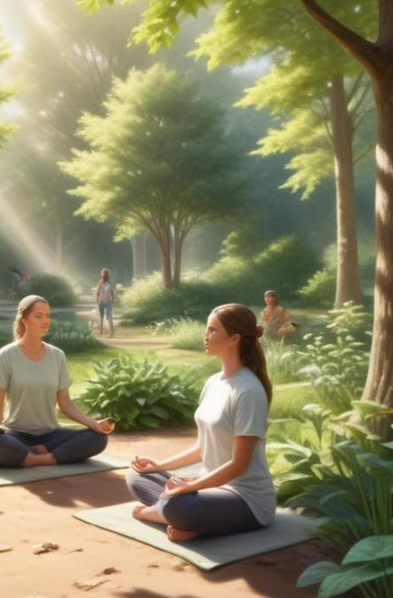
02
Holistic Solutions

Slide 10

Personal growth strategies
Personal growth strategies prioritize self-reflection, goal setting, and lifelong learning. By engaging in practices such as mindfulness and emotional intelligence, individuals can enhance self-awareness, boost resilience, and foster a commitment to continuous improvement. These strategies enable individuals to cultivate a balanced approach to life, promoting both personal well-being and a positive impact on society.
Goal-setting helps define purpose and direction, enabling individuals to stay motivated and achieve success in various aspects of life.
Continuous learning promotes adaptability and success, keeping individuals updated with new knowledge, skills, and experiences.

Slide 11

Conflict resolution methods
Conflict resolution is a vital skill for maintaining healthy relationships. Effective communication, empathy, and negotiation techniques prevent misunderstandings and foster cooperation, helping individuals resolve disputes in personal and professional settings.
Active listening strengthens understanding by allowing individuals to express their thoughts and concerns clearly and respectfully.
Negotiation skills help achieve fair resolutions, ensuring mutual benefit and long-term harmony in relationships.
Empathy fosters peace by encouraging individuals to consider others' perspectives and emotions before reacting to situations.

Slide 12

Sustainable living practices
Sustainable living practices encompass a variety of lifestyle choices aimed at minimizing our ecological footprint. These practices include reducing waste, conserving resources, and making ethical consumer choices. By embracing sustainability, individuals contribute to the health of the planet and promote social equity. Awareness and education about sustainability encourage a collective commitment to preserving resources for future generations.

Slide 13

Mind-Body Wellness
A holistic approach to well-being integrates both mental and physical health to create a balanced and fulfilling life. Mind-body wellness focuses on achieving harmony through various practices:
Physical Health and Well-being: Regular exercise, a balanced diet, and sufficient rest contribute to overall well-being. Physical activity not only strengthens the body but also improves mental clarity and emotional stability.
Mindfulness and Stress Management: Practices such as meditation, deep breathing, and yoga help individuals manage stress, increase focus, and cultivate emotional resilience.
Emotional Intelligence and Self-awareness: Developing emotional intelligence enables individuals to manage their emotions effectively, enhance relationships, and make rational decisions.

Slide 14

Conclusions
In conclusion, understanding human conduct involves examining the psychological, cultural, and ethical influences that shape behavior. By adopting holistic solutions such as personal growth strategies, conflict resolution methods, and sustainable living practices, we can foster an interconnected approach to living that promotes individual well-being, societal harmony, and global sustainability.

Slide 15
Thank you!
+91 620 421 838

